Slide 1
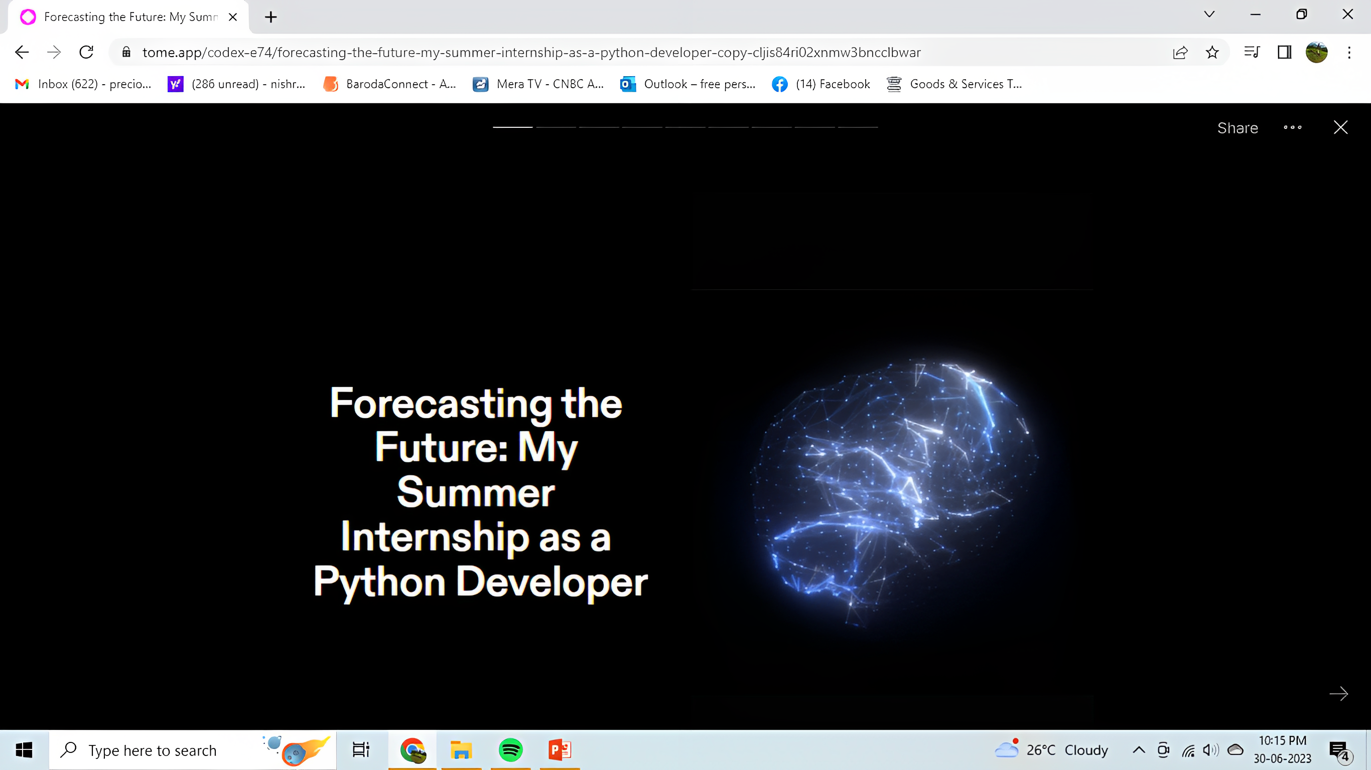
Forecasting the
Future: My
Summer
Internship as a
Python Developer

Slide 2
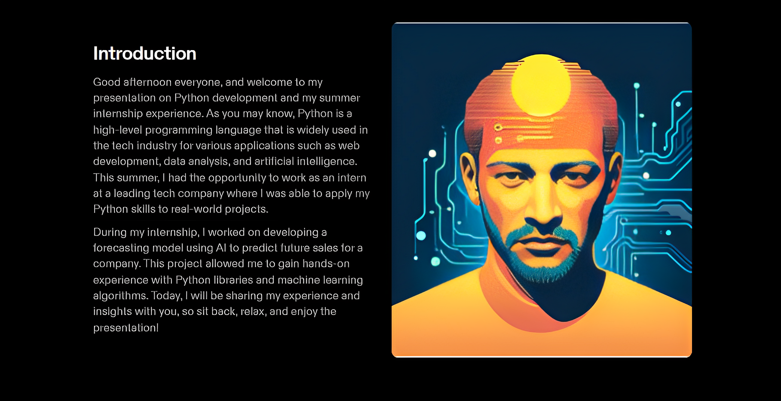
Internship Overview
This summer, I had the opportunity to work as an intern under Mr. Prerak Shah who works at Meta in US where I was able to apply my Python skills to real-world projects. During my internship, I worked on developing a forecasting model using Al 1o predict future sales for a company. This project allowed me to gain hands-on experience with Python libraries and machine learning algorithms. Today, I will be sharing my experience and insights with you, so sit back, relax, and enjoy the presentation

Slide 3
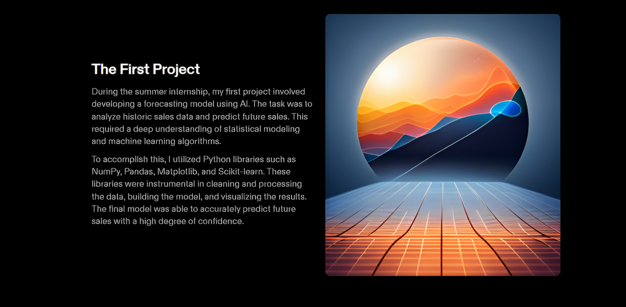
The First Project
During the summer internship, my first project involved developing a forecasting model using AI. The task was to analyze historic sales data and predict future sales. This required a deep understanding of statistical modeling and machine learning algorithms. To accomplish this, I utilized Python libraries such as NumPy, Pandas, Matplotlib, and Scikit-learn. These libraries were instrumental in cleaning and processing the data, building the model, and visualizing the results. The final model was able to accurately predict future sales with a high degree of confidence.

Slide 4
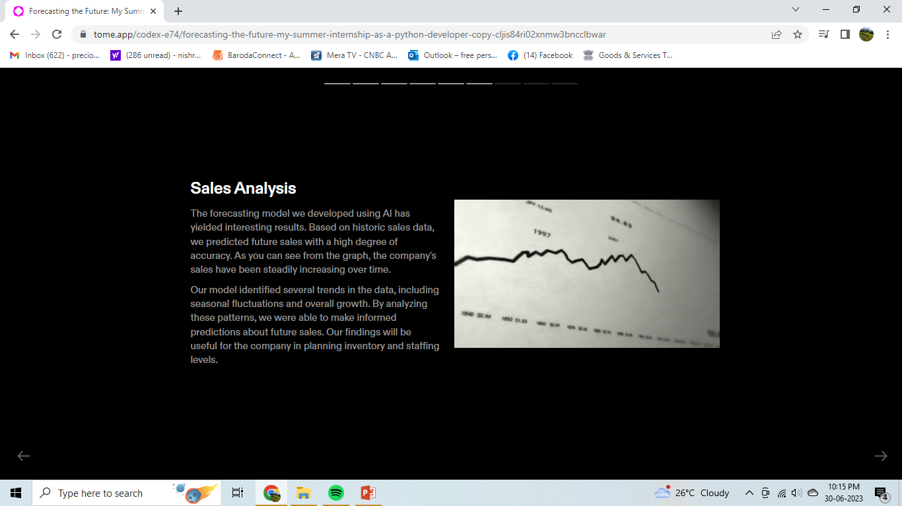
Sales Analysis
The forecasting model we developed using AI has yielded interesting results. Based on historic sales data, we predicted future sales with a high degree of accuracy. As you can see from the graph, the company’s sales have been steadily increasing over time. Our model identified several trends in the data, including seasonal fluctuations and overall growth. By analyzing these patterns, we were able to make informed predictions about future sales. Our findings will be useful for the company in planning inventory and staffing.

Slide 5
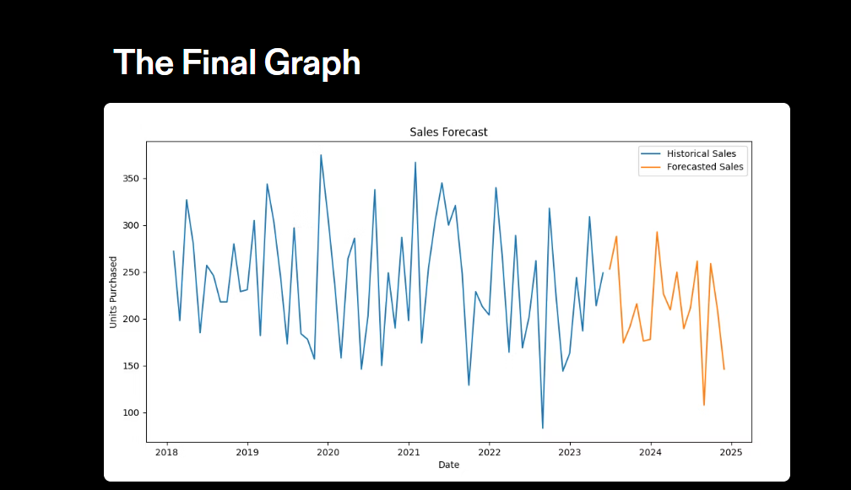
The Final Graph

Slide 6
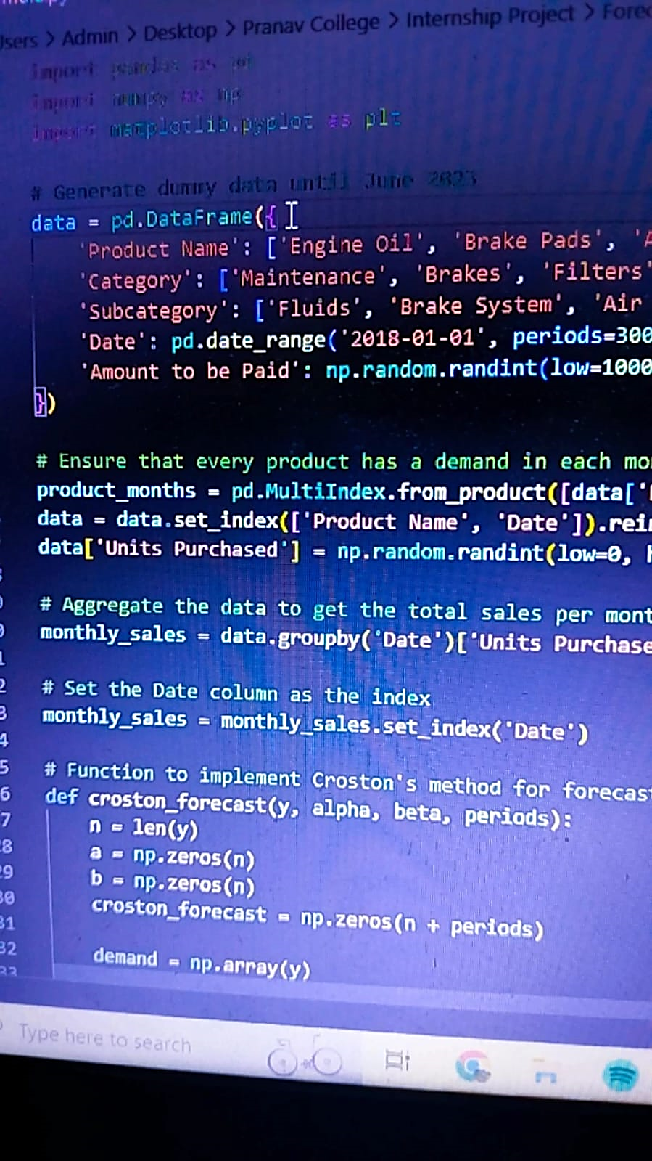
Lessons Learnt
During my summer internship, I learned many valuable lessons that will undoubtedly prove useful in my future endeavors. One of the most important technical skills I developed was the ability to analyze and interpret data using Python. This involved learning how to manipulate large datasets, identify trends, and use various statistical methods to draw meaningful conclusions. In addition to technical skills, I also gained invaluable experience in professional development. Through interactions with my colleagues and supervisors, I learned how to communicate effectively, collaborate on projects, and manage my time efficiently. These skills will be essential as I continue to pursue a career in Python development.

